Slide 1
NIEM Health 201: Architecting NIEM Health IEPDs using Health Information Models
Cait Ryan
Brian Handspicker

Slide 2
NIEM Health Guidance Documents
NIEM Health 101: An Introduction to Health Information Exchange
NIEM Health 102: An Introduction to Security and Privacy of Protected Healthcare Information
NIEM Health 201: Architecting NIEM Health IEPDs using Health Information Models
NIEM Healthcare Elements Inventory
Notes:
The Federal Health Architecture (FHA) has published a series of National Information Exchange Model (NIEM) guidance documents for the NIEM Health Community of Interest (NH-COI) and NIEM stakeholders at large:
• NIEM Health 101: An Introduction to Health Information Exchange
• NIEM Health 102: An Introduction to Security and Privacy of Protected Healthcare Information
• NIEM Health 201: Architecting NIEM Health IEPDs using Health Information Models
• NIEM Healthcare Elements Inventory
This presentation is the third in the series - NIEM Health 201: Architecting NIEM Health IEPDs using Health Information Models..

Slide 3
NIEM Health 201
This presentation will outline:
The NIEM Health Challenge
Existing NIEM Healthcare Elements Inventory and USCDI 2018 Model Mapping
How to traverse from health IT standard information models to NIEM elements
Step-by-step example of creating a NIEM Health IEPD
Notes:
NIEM Health 201, the third of the NIEM guidance documents, provides an overview of health information models and demonstrate how to use FHIM, within the National Information Exchange Model (NIEM) Information Exchange Package Documentation (IEPD) Lifecycle process, to identify key health IT data elements that are needed for a NIEM community scenario.
By the end of this tutorial you should:
Understand the NIEM Health Challenge
Know what the FHIM is
Know about existing NIEM Healthcare Elements and NIEM Healthcare USCDI 2018 (revised 2019 version) Model Mapping
Understand how to traverse from health IT standard information models represented in the FHIM to NIEM elements
Experienced a step-by-step example of creating a NIEM Health IEPD

Slide 4
What is NIEM?
The National Information Exchange Model is a common vocabulary that enables efficient information exchange across diverse public and private organizations:
NIEM breaks down interagency stovepipes
NIEM enables agencies to share information that crosses system, agency, and jurisdictional borders
NIEM improves decision-making, agility, and efficiency in satisfying business needs
NIEM supports interoperability and reuse, reducing costs
Notes:
The National Information Exchange Model (NIEM) is a common vocabulary that enables efficient information exchange across diverse public and private organizations. NIEM connects communities of people who share a common need to exchange information in order to advance their mission.
As NIEM's adoption continues to grow, non-clinical domains that utilize health data elements for information exchange will require clinical informatics subject matter expertise to successfully navigate through the complexities of the HIT/HIE environment. Furthermore, operational HIT/HIE safeguards must be in place to ensure that the exchange of health information is always legal, secure, and private. The real world challenge is to harmonize across all information exchange standards, NIEM-based and Health Information-based.

Slide 5
NIEM Health Challenge
NIEM adoption is increasing at all levels of government
Growing demand for clinical health elements within NIEM exchanges outside HIT/HIE systems - Prisons, Courts, Emergency, etc.
Challenge: Harmonize NIEM with clinical health standards
Opportunity: Formalize the relationship between NIEM and Health Communities
Health
Justice
Human Services
MilOps
Emerg. Mgmt.
Notes:
As NIEM's adoption continues to grow, non-clinical domains that utilize health data elements for information exchange will require clinical informatics subject matter expertise to successfully navigate through the complexities of the HIT/HIE environment. Many NIEM-based communities, such as Justice, Homeland Security, Child and Family Services, need to be able to exchange domain-specific, albeit limited, healthcare information. Their challenge is to be able to exchange this limited healthcare information within their communities using NIEM-based technologies while preserving interoperability with the healthcare information source communities.

Slide 6
Existing NIEM Health Elements
~327 existing NIEM Health Elements defined across:
NIEM Core (~62),
Biometrics (2),
Emergency Management (10),
Human Services (~90),
Justice (~161),
Screening (2)
Few defined based on HL7 Health IT standards
Challenging to map cleanly between NIEM IEPDs and HL7 Messages
Notes:
FHA inventoried existing health related elements already modeled throughout the NIEM domains. We identified over 300 NIEM health related elements defined across 6 different domains.
We realized that the majority of the current NIEM health elements are not based on healthcare data model standards and many were defined in the context of very narrow use-cases rather than being generally useable.
In addition it is near impossible to understand who defined these elements, whether they are still or were ever used, and for what purpose were they defined due to a lack of a NIEM repository.

Slide 7
NIEM Health Modeling – USCDI & FHIM
USCDI Data Classes | V | #¹ | FHIM | NIEM | C-CDA | FHIR
Patient name | 1 | 1 | Included | Yes | Yes | Yes
Sex (birth sex) | 1 | 1 | Included | Yes | Yes | Yes
Date of Birth | 1 | 1 | Included | Yes | Yes | Yes
Preferred Language | 1 | 1 | Included | Yes | Yes | Yes
Race | 1 | 1 | Included | Yes | Yes | Yes
Ethnicity | 1 | 1 | Included | Yes | Yes | Yes
Smoking Status | 1 | 1 | Included | NO | Yes | Yes
Laboratory tests | 1 | ~80 | Included | NO | Yes | Yes
Laboratory values/results | 1 | ~80 | Included | NO | Yes | Yes
Vital signs | 1 | ~45 | Included | NonStd | Yes | Yes
Problems | 1 | ~75 | Included | NonStd | Yes | Yes
Medications | 1 | ~95 | Included | NonStd | Yes | Yes
Medication Allergies | 1 | ~20 | Included | NO | Yes | Yes
Health concerns | 1 | ~75 | Included | NO | Yes | Yes
Care Team members | 1 | ~40 | Included | NonStd | Yes | Yes
Assessment and plan of treatment | 1 | ~40 | Planned | NO | Yes | Yes
Immunizations | 1 | ~60 | Included | NO | Yes | Yes
Procedures | 1 | ~30 | Planned | NO | Yes | Yes
UDI | 1 | ~40 | Included | NO | Yes | Yes
Goals | 1 | ~95 | Included | NO | Yes | Yes
Provenance | 1 | ~25 | Included | NO | Yes | Yes
Clinical Notes | 1 | ~60 | Planned | NO | Yes | Yes
US Core Data Interoperability (USCDI) Requirements
USCDI structured into annual incremental requirements - 2018, 2019, 2020, 2021
~600 health requirements in USCDI ’18
USCDI ‘18 aligns with Meaningful Use Common requirements (MU Common) and Continuity of Care docs supported by C-CDA and FHIR
Using USCDI to guide modeling NIEM healthcare elements conformant with health IT standards
Using FHIM as a common authoritative source of health standards information modeling – a healthcare information “Rosetta Stone”
V1-2018 | v2-2019 | v3-2020 | v4-2021
Notes:
The Office of the National Coordinator for Health IT (ONC) has produced a requirements document for healthcare IT systems and standards information interoperability - the US Core Data Interoperability requirements:
Annual incremental requirements - 2018, 2019, 2020, 2021
~600 health requirements in USCDI ’18
USCDI ‘18 aligns with Meaningful Use Common requirements (MU Common) and Continuity of Care docs supported by C-CDA and FHIR
We are:
Using USCDI to guide modeling NIEM healthcare elements conformant with health IT standards
Using FHIM as a common authoritative source of health standards information modeling – a healthcare information “Rosetta Stone”

Slide 8
Health Information Standards & FHIM
Federal Health Information Model (FHIM):
a logical health information model
that supports semantic interoperability between standards,
by harmonizing information and terminology content across federal partners and SDOs,
so that it standardizes data concepts and serves as a repository of such concepts.
FHIM is an implementation-neutral reference tool that can be used to generate standards-based interoperability.
Notes:
FHIM is a platform independent logical health information model that supports semantic interoperability through a comprehensive set of implementation guides. The model harmonizes health information and terminology across federal partners and SDOs and serves as a repository of such concepts. FHIM is an implementation-neutral reference tool that we are using to generate interoperable NIEM Health elements based on healthcare standards.

Slide 9
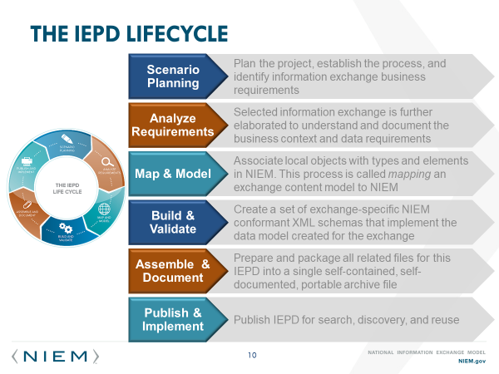
The IEPD Lifecycle
Notes:
The NIEM Information Exchange Package Documentation (IEPD) lifecycle is a six stage collaborative process involving multiple team players, including technical stakeholders (e.g. Data Architects, Data Modelers, Developers), Business Analysts, and Subject Matter Experts (SMEs). Since this is an interoperable exchange effort between two or more entities, it is critical for all stakeholders, on all sides of the exchange, to participate in the planning, development, and execution of the exchange.
For the purposes of this tutorial, the focus is specifically on the second “Analyze Exchange Requirements” stage of the IEPD life cycle. You should have your scenarios ready for the next step in this process.

Slide 10
Analyze Exchange Requirements
Data elements – The data fields of a message
Element name
Data type
Definition
Occurrence constraints
Default occurrence constraints
Source Information
Objects/Classes – The complex, reusable data structures where related elements are grouped together
Code Sets – The list of allowable values (e.g. state codes, eye color)
Conditions/Business Rules – There may be certain restrictions on the content that needs to be represented
Notes:
The NIEM IEPD Analyze Exchange Requirements stage requires analysis of data exchange requirements (e.g. content requirements, exchange partners, conditions that trigger an exchange, security requirements, etc.). The content portion of the requirements analysis stage may be captured in the following preferred formats: document, spreadsheet (recommended by FHA, see below), or UML diagram. The kinds of information to be captured include:
Data elements:
Element
Data type
Definition
Occurrence constraints
Default occurrence constraints
Source information
Objects / Classes
Code Sets
Conditions / Business Rules
NOTE: The other requirements of the exchange – technical, security and privacy, performance, reporting, etc. should be described in this stage as well.

Slide 11
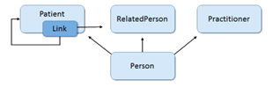
Modeling Patient User Story
Person Data Model derived from User Story
Notes:
For the purpose of this tutorial we will assume a user story of the need to generate a report of a patient’s visits to provider, which will require a minimal set of patient demographics as defined by USCDI 2018/2019. This represents a very small subset of the information to be exchanged between, for example a FHIR-based HIE and a NIEM-based system. (See backup slides for more user story context.)

Slide 12
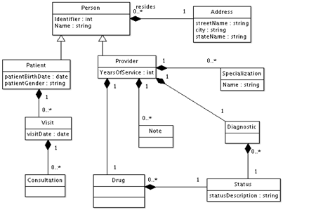
Modeling Patient-related Data
Data Model for User Story
Notes:
Once a user story has been defined a data model is created. This logical data model may then be use to map to corresponding FHIM Vocabulary resources. For this tutorial we will focus on the elements required for “Person” and “Patient” in this data model.

Slide 13
Create data mapping spreadsheet
Label columns for NIEM/FHIM/Value-sets
Scenario Object Class | Scenario Element | Scenario Element Definition | FHIM Class Qualified Name | FHIM Property Name | FHIM Property Documentation | FHIM Data Type | NIEM Object Class | NIEM Element | NIEM Element Definition | NIEM Element Type | Value-set Source | Value Set-Binding | Notes
The name of the data object class you need for exchange | The name of the data element you need for exchange | A clear and cogent definition of your data element | The fully qualified class name from FHIM | The name of the property from FHIM that most closely matches scenario element | The description of the property from FHIM that most closely matches the scenario element | The data type of the FHIM property | The fully qualified class name from NIEM | The name of the NIEM element that most closely matches the scenario element | The description of the element from NIEM that most closely matches the scenario element . | The data type of the NIEM element | The name of the value-set | Binding to a particular set of values | Notes about this value set
Notes:
With a logical data model defined we can start the process of mapping to healthcare standards elements using FHIM, NIEM elements, and vocabulary value-set bindings using VSAC.
NIEM and FHA recommend using a spreadsheet to record the details of each element needed for an IEPD.
Label columns for Scenario Requirements, FHIM, NIEM, and value-sets to aid in mapping the source elements to semantic equivalent.
Populate the scenario elements and their definitions first, then proceed to locate these scenario elements in FHIM and NIEM by downloading the models and/or using online tools.

Slide 14
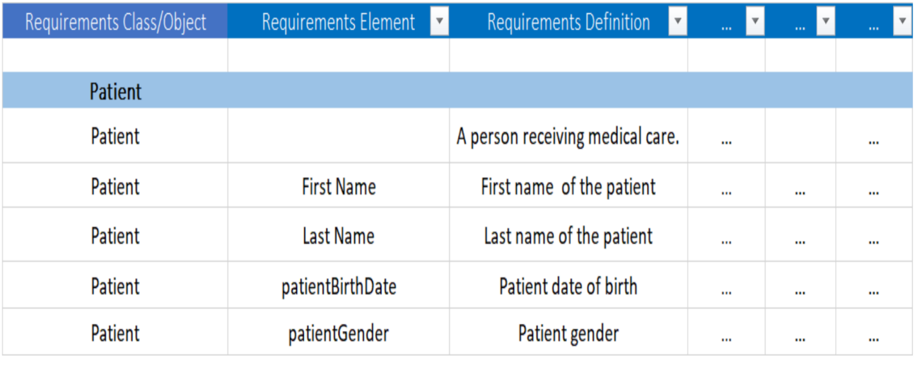
Defining Scenario Requirements
Use Case: USCDI 2018 Demographics Elements
Notes:
To populate this spreadsheet we first fill in the fields for the data elements required by the user story (or scenario) as defined by our scenario logical data model.
[Note minor typo in image: should be “Person” class for First and Last Name, not “Patient”]

Slide 15
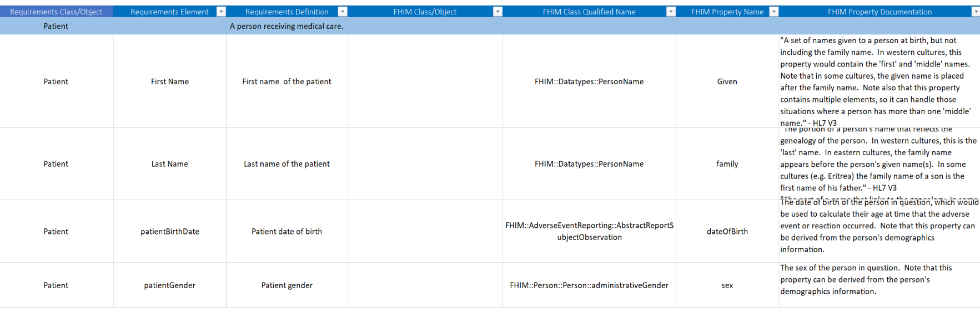
Mapping Requirements to FHIM
Using FHIMview.com or FHIMS.org
Notes:
Next we find semantic equivalents for these element requirements in the healthcare standards using the FHIM as a type of data dictionary/thesaurus.
Within the Class Documentation and the Property Documentation columns, there are references to which standards that the specific element is bound to.
There are three ways to view the FHIM:
Option 1: View the UML model of each domain at http://FHIMview.com
Option 2: View the UML model of each domain at http://fhims.org
Option 3: Download the spreadsheet of all data elements from http://fhims.org
NOTE: Option 2: Upon clicking on the link, you will navigate to the list of FHIM Domains. Double click on a FHIM Domain to explore the UML Model for that Domain. You may also click on + Diagrams or on + Models at the upper left to see the drop-down items.
NOTE: Option 3: For access to the domain elements, you will need to download the FHIM Data Elements spreadsheet which includes the data elements of all domains. This provides the means to search through all the domains for the elements you are looking for.

Slide 16
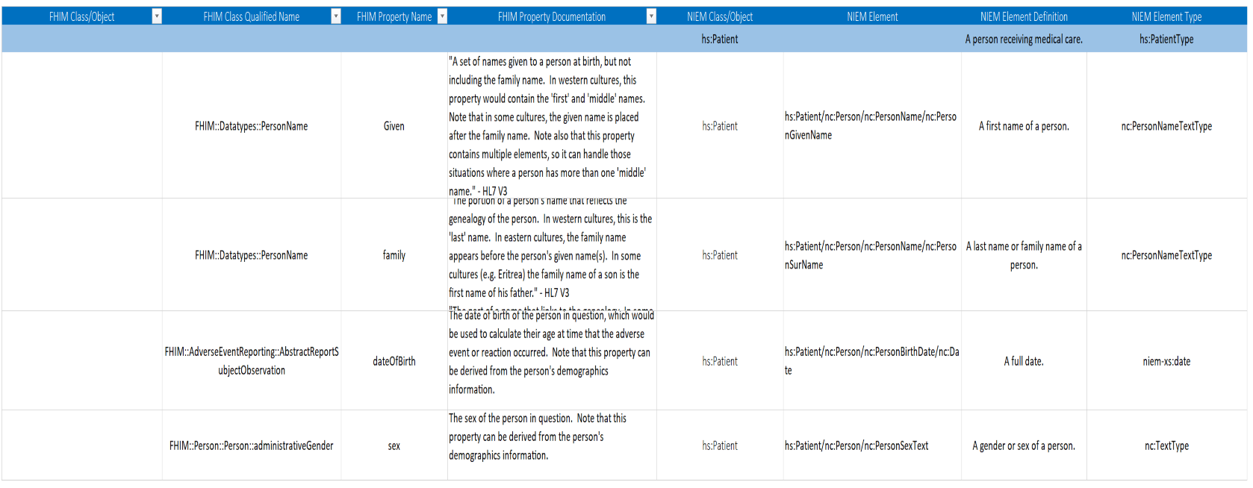
Mapping Requirements to NIEM
Notes:
Next we map the scenario requirements and FHIM referenced healthcare standards to existing NIEM elements, where they exist. If they do not yet exist in a NIEM Domain you may use these spreadsheet cells to define your requirements for new NIEM extension elements. We recommend highlighting the background of cells that specify elements that do not yet exist so that you can avoid frustration when we get to the subset tool generation step… but this is advanced NIEM development which we will not cover in this tutorial.
There are four ways to view NIEM Domain Elements:
Option 1: View the UML model of each domain at http://FHIMview.com/NIEMview
Option 2: View the UML model of each domain using the Movement tool at https://beta.movement.niem.gov/
Option 3: Download the zip file of the schema for all data elements from http://niem.github.io/niem-releases/
Option 4: Search for matching NIEM elements using the NIEM Subset Schema Generator Tool at https://tools.niem.gov/niemtools/ssgt/index.iepd

Slide 17
Mapping Requirements to Value-sets
Health Vocabulary Standards
Acronym | Title | Description
SNOMED | Systematized Nomenclature of Medicine-Clinical Terms | Nomenclature copyrighted by the College of American Pathologists; includes diseases, clinical findings, etiologies, procedures, and outcomes
ICD-10 | International Classification of Diseases, 10th Edition | Overlaps with SNOMED in diseases, events and findings
LOINC | Logical observation Identifiers Names and Codes | Overlaps with SNOMED in findings and measures
CPT | Current Procedural Terminology | Overlaps with SNOMED in procedures/interventions concepts. Not as granular as LOINC; also used for insurance data exchange.
X12 | Claim Status Codes | Similar to CPT but focused for insurance claims, not specific enough for clinical reporting
UMLS | National Library of Medicine’s Unified Medical Language System ® | Meta vocabulary collection that includes ICD-10, LOINC, CPT, and SNOMED
Notes:
Finally, many elements are dependent on standard sets of acceptable values that are defined either by protocol standards or by industry standard vocabularies. Vocabulary standards were developed to ensure semantic and syntactical consistency with the characteristics and attributes for clinically specific patient medical record information terminologies. For example the DICOM protocol has 13 standard values for gender, while the FHIR protocol has only 3 values for gender. In your mapping spreadsheet it is important to specify what value-set binding and values you will be supporting for each element that has a constrained set of values.
FHIM has references to the preferred vocabulary value-sets and values for each standard healthcare element.
Most of the applicable vocabulary standards have been discussed in NIEM Health 101. For example, health vocabulary standards include:
• SNOMED CT (Systematized Nomenclature of Medicine-Clinical Terms)
• RxNorm
• LOINC (Logical Observation Identifiers Names and Codes)
• CPT® (Current Procedural Terminology)
• ICD-10 (International Statistical Classification of Diseases and Related Health Problems 10th revision)
• X12 (Claim Status Codes)
• UMLS (Unified Medical Language System)
• DSM-5 (The Diagnostic and Statistical Manual of Mental Disorders)
These vocabularies can be found in a single place online at http://vsac.nlm.nih.gov.
BACKGROUND INFO TO HELP ANSWER QUESTIONS:
• SNOMED CT (Systematized Nomenclature of Medicine-Clinical Terms): developed by the International Health Terminology Standards Development Organization (IHTSDO), it is comprehensive, multilingual clinical healthcare terminology originally intended to record observations for pathologists
• RxNorm: developed by the National Library of Medicine (NLM), it provides normalized names for clinical drugs and links its names to many of the drug vocabularies commonly used in pharmacy management and drug interaction software
• LOINC (Logical Observation Identifiers Names and Codes): developed by Regenstrief, LOINC serves as an international standard for identifying health measurements, observations, and documents and was originally intended for reporting lab results
• CPT® (Current Procedural Terminology): developed by the American Medical Association (AMA) for the purpose of billing outpatient & office procedures
• ICD-10 (International Statistical Classification of Diseases and Related Health Problems 10th revision): a medical classification list developed by the World Health Organization (WHO). It contains codes for diseases, signs and symptoms, abnormal findings, complaints, social circumstances, and external causes of injury or diseases. ICD-10 is commonly used for billing purposes.
• DSM-5 (The Diagnostic and Statistical Manual of Mental Disorders): developed and administered by the American Psychiatric Association (APA), serves as a psychiatric classification and diagnostic reference tool

Slide 18
Generate NIEM IEPD Subset
NIEM Schema Subset Generator Tool (SSGT)
Notes:
At this point your mapping spreadsheet is complete. To actually use these NIEM element mappings usually requires a number of supporting classes, types and elements defined across the NIEM Domains. However, most IEPD implementations don’t require the full breadth and depth of all of the NIEM Domain schema definitions. To ease assembling the necessary subset of the NIEM XML Schema Definitions (XSD) for a compliant IEPD you may use the NIEM Schema Subset Generator tool (SSGT) available at https://tools.niem.gov/niemtools/ssgt/index.iepd.

Slide 19
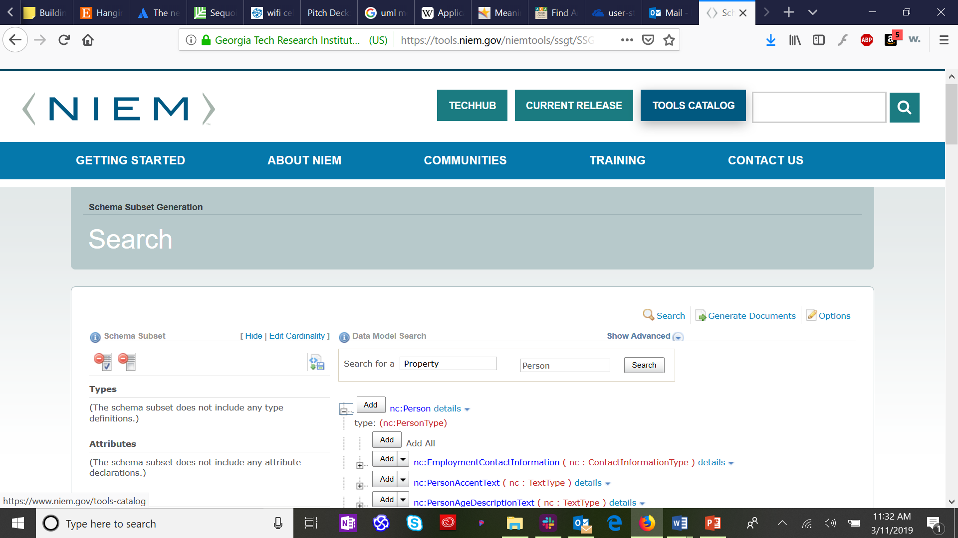
Searching for NIEM Elements & Types
Search for Person
Notes:
By searching for the “Property” “Person” we get a list of all elements defined across all domains associated with “Person”. By clicking on the plus sign next to “nc:Person” (NIEM Core domain definition of Person) it will expand to a list of those elements that are part of the class nc:Person. This is a very long list of elements, most of which aren’t associated with healthcare information for a person.

Slide 20
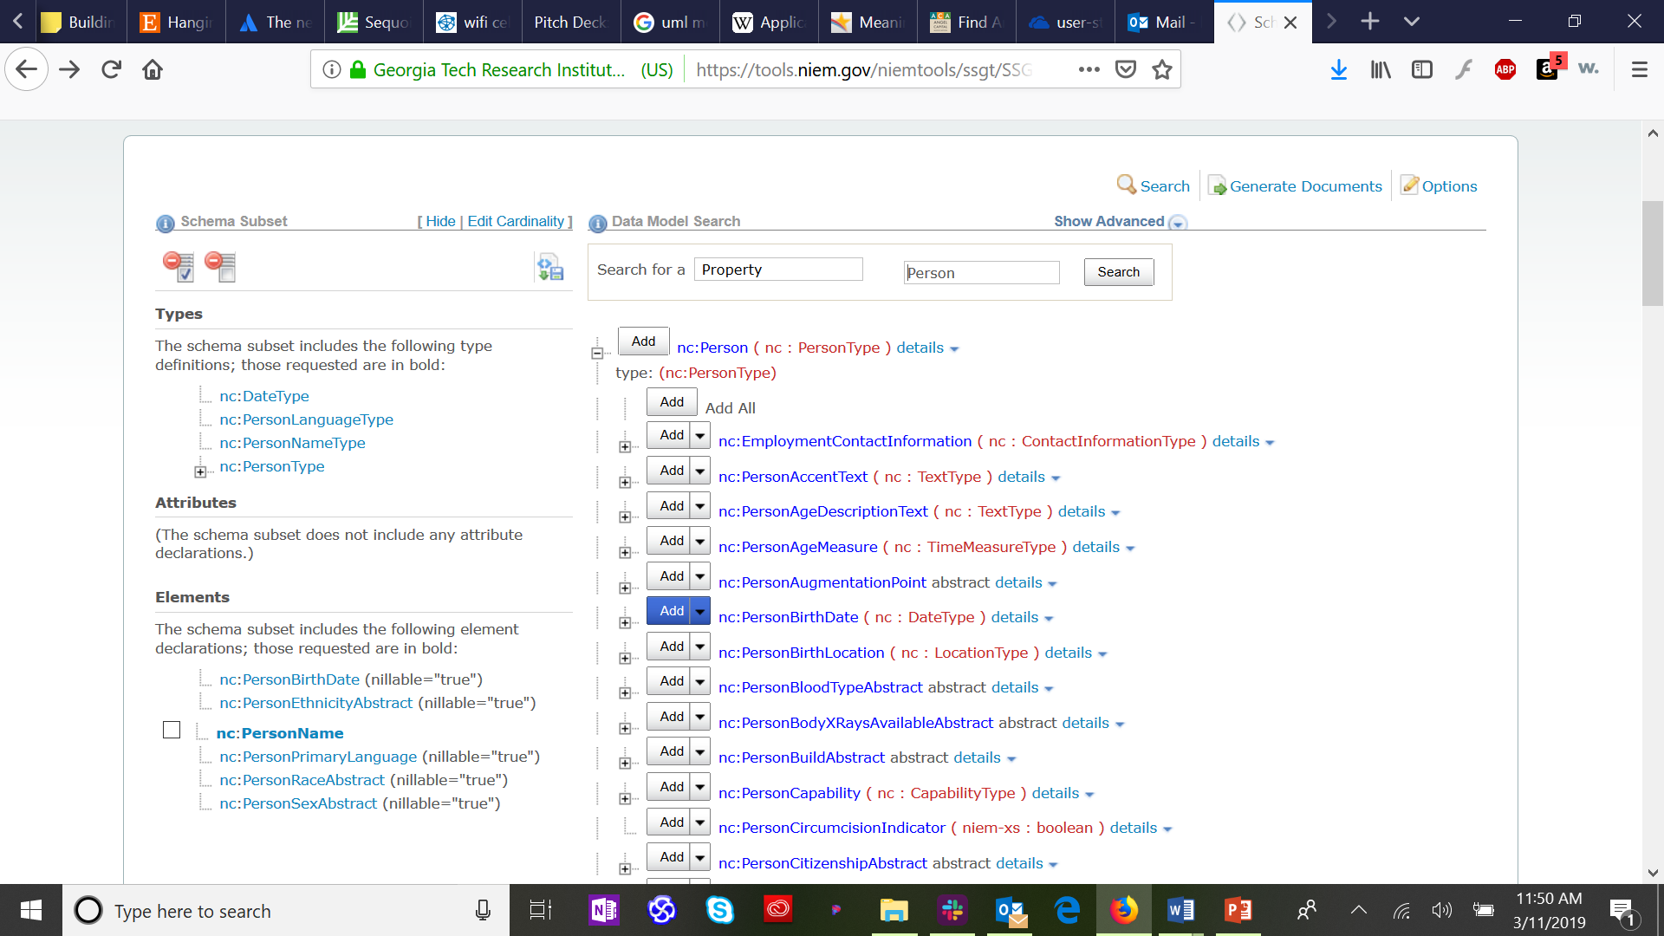
Selecting NIEM Elements
Patient::Person Demographics
Notes:
We can select just those elements we need for our scenario by clicking on the “Add” button next to an element we need. This will add the element to our elements list in the left hand column. By default this element will have the constraint “0..∞” which means that this element can be left out of an exchange altogether (0 times, or nillable) or it can have many instances in a message (up to infinite, ∞ times). This means that you are defining an element which might not be knowable at the time of an information exchange, for example race, and therefor you allow zero instances of that element in an exchange message. It also allows your element to have multiple values, for example race of Caucasian and Native American.
By selecting the down arrow next to the add button you can select a required constraint. If you are defining an element which might not be knowable at the time of an information exchange, for example ethnicity, you should ensure the constraint allows zero instances of that element. If you are defining an element that might have multiple values, for example “race”, you should ensure the constraint allow multiple instances. If you have an element that must have no more than one element but which might be missing at the time of exchange, such as SSN, define the constraint as 0..1. Similarly if you have an element that must always be defined, such as surname but for which there might be more than one value, use constraint 1..∞. Finally, for those elements that are required, but for which you should have one and only one, define the constraint at 1..1.

Slide 21
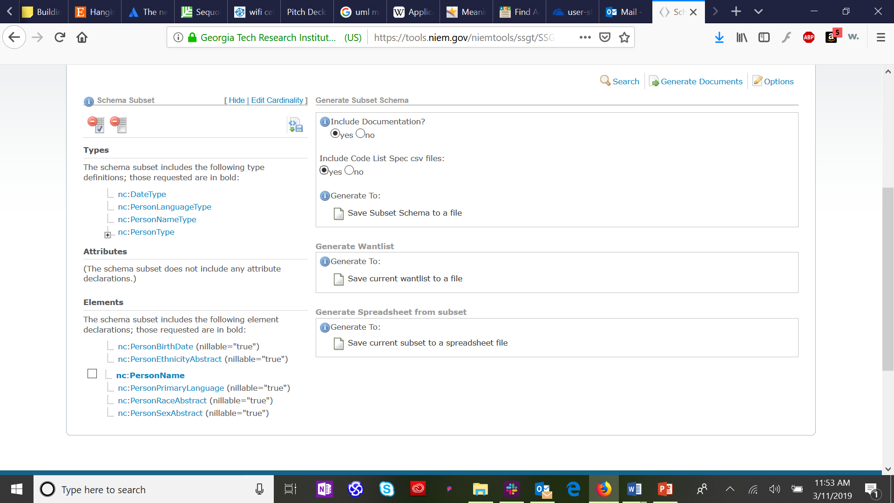
Generating NIEM Schema Subset
Creates Architecture and Implementation Artifacts
Notes:
Once you have added all your required NIEM elements to your subset list, select the “Generate Documents” link in the upper right of the SSGT window. This will bring up this screen. Select “Save Subset Schema to a file” which will generate a zip file containing all the folders and schema files necessary to kick-start your IEPD development.

Slide 22
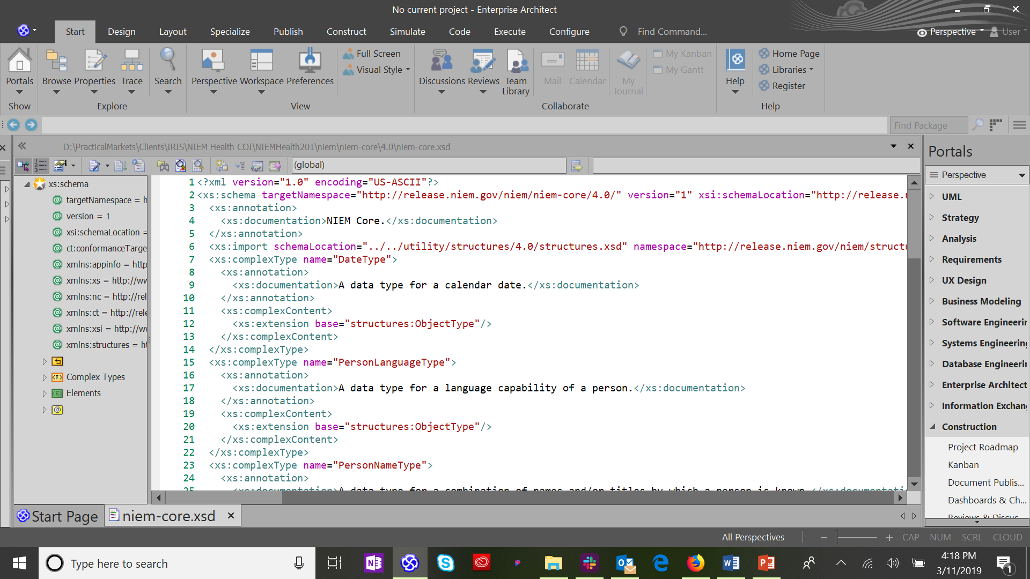
Generated NIEM XML Schema
Notes:
The generated schema subset zip file will include a folder for “niem” which will contain the complete set of dependent NIEM schema elements for your IEPD. Here that simple first user story data model is shown in Sparx EA.

Slide 23
Conclusion
Functional interoperability, both within and outside information exchanges, is the key to accurate, useful, and secure information exchange networks.
FHIM and NIEM can be leveraged together to increase accuracy and to ease the development of functional interoperability between federal, local, state, and tribal health entities by adopting and integrating the standardized use and exchange of health data amongst various public health entities.
Notes:
Functional interoperability, both within and outside Health Information Exchanges, is the key to accurate, useful, and secure information exchange networks. Currently, disparate interoperability standards vary between HIT organizations and their stakeholders. Furthermore, the lack of consistent standards adoption impedes HIE interoperability on both a national and regional scale. FHIM can provide a means to harmonize competing standards and produce artifacts that will improve the quality of implementations through model-to-model transformations. Information exchanges have numerous requirements related to standards and terminology. Their diverse data sets and cross-domain relevance require the FHIM logical model to describe the contents of the information exchanges (e.g., HL7, NIEM). Thus, FHIM and NIEM can be leveraged together to increase accuracy and to ease the development of functional interoperability between federal, local, state, and tribal health entities by adopting and integrating the standardized use and exchange of health data amongst various public health entities.

